Slide 1

Investment Banking Pitchbook Template
Insert Date

Slide 2
Table of Contents
Company Overview |  | 4 |  | Transaction Opportunities |  | 20
 | Company Overview | 5 |  |  | Strategic Review and Opportunity | 21
 | Business Model | 6 |  |  | Recommendation 1 | 22
 | Operating Forecast | 7 |  |  | Recommendation 2 | 23
 | Shareholder Ownership | 8 |  |  | Recommendation 3 | 24
 | Liquidity Analysis | 9
Industry Overview |  | 10 |  | Team Overview |  | 25
 | Competitive Environment | 11 |  |  | Investment Banking Team | 26
 | Key Industry Trends | 12 |  |  | Deal Tombstones | 27
 | Corporate Finance Activity | 13
Valuation |  | 14 |  | Appendices |  | 28
 | Historical Share Price Performance | 15
 | Valuation Overview | 16
 | Valuation Analysis | 17
 | Comparables Overview | 18
 | Precedents Overview | 19

Slide 3
Executive Summary
Why?
What?
Next Steps

Slide 4
Company Overview

Slide 5
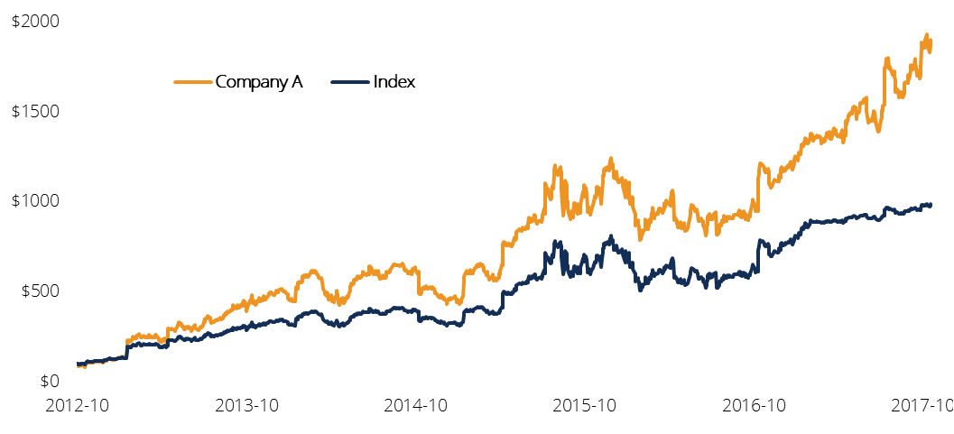
Company Overview
Company Highlights
Valuation & Share Performance
History: (What year was the company found? Who founded it? What key milestones has the company achieved?)
Valuation: (How has the stock performed? What is the market pricing in? What are the drivers behind their success? What are some of the key investment highlights?)
Strategy: (What is the company focusing on? What has company management iterated about strategy? What makes their strategy strong? What are the key details of the company’s strategy?)
Corporate Finance Transactions: (What are some of the companies most recent/notable/transformative acquisitions? Did they raise any equity/debt capital? Did they IPO recently?)
Ownership: (Who are the top shareholders? What % ownership? Value of ownership?)
Key Valuation Statistics ($mm)
Enterprise Value | $2,626.90 | Revenue (FY18e) | $968
Market Cap | $2,228.20 | EBITDA (FY18e) | $310
P/E* | 39.6x | EBITDA Margin | 32%
EV/EBITDA* | 8.5x | Debt / EV | 17%
Cash | $320 | Total Debt | $450
*P/E and EV/EBITDA are based on FY18(e) for comparison
Industry Data | Average
Relevant Industry Vertical A
EV/EBITDA
EV/Revenue
P/E
Relevant Industry Vertical B
EV/EBITDA
EV/Revenue
P/E
Revenue Mix | % | Gross ($mm)
Segment A | % | $
Segment B | % | $
Segment C | % | $
Share Price | Current: $40.00 | High/Low: $50.15 / $35.79
Key Metrics | Unit
Operating Data
Operating Data
Operating Data
Operating Data
Operating Data
Operating Data
1
2
3
4
5
Company Overview
Industry Overview
Valuation
Transaction Opportunities
Team Overview

Slide 6
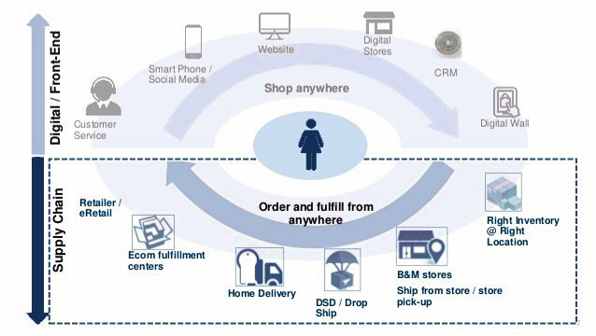
Business Model
Industry Value Chain
Business Model Element 1:
Business Model Element 2:
Business Model Element 3:
Industry Theme 1:
Overarching Competitive Advantage: (What makes this part of their business model significant? What is the competitive landscape like? What are they key industry themes and trends?)
(e.g. Provide an example)
Industry Theme 2:
1
2
3
4
5
Company Overview
Industry Overview
Valuation
Transaction Opportunities
Team Overview

Slide 7
Operating Forecast
Revenue Drivers
Segment A:
(What is most impressive about this segment? How does it compare to previous periods?)
(What is the forecasted growth rate? What is driving growth in this particular segment?)
(What is the significance of this? How are the company’s competitors faring?)
(What are some catalysts for this business segment? What opportunities exist?)
Segment B:
(What is most impressive about this segment? How does it compare to previous periods?)
(What is the forecasted growth rate? What is driving growth in this particular segment?)
(What is the significance of this? How are the company’s competitors faring?)
(What are some catalysts for this business segment? What opportunities exist?)
Segment C:
(What is most impressive about this segment? How does it compare to previous periods?)
(What is the forecasted growth rate? What is driving growth in this particular segment?)
(What is the significance of this? How are the company’s competitors faring?)
(What are some catalysts for this business segment? What opportunities exist?)
Revenue & EBITDA Forecast
(in millions of U.S. dollars) | 2014 | 2015 | 2016 | 2017E | 2018E | 2019E | 2020E | 2021E
Segment A | 295.2 | 331.6 | 343.4 | 412.2 | 503.8 | 521.3 | 535.9 | 547.8
Segment B | 177.1 | 197.7 | 203.3 | 242.5 | 294.5 | 302.8 | 309.4 | 314.3
Segment C | 118.1 | 127.4 | 126.6 | 145.7 | 170.5 | 168.8 | 165.8 | 161.8
Total Revenues | 590.4 | 656.7 | 673.3 | 800.3 | 968.8 | 992.9 | 1,011.2 | 1,023.9
Segment A Revenue Growth, % |  | 12.3% | 3.5% | 20.0% | 22.2% | 3.5% | 2.8% | 2.2%
Segment B Revenue Growth, % |  | 11.6% | 2.9% | 19.3% | 21.5% | 2.8% | 2.2% | 1.6%
Segment C Revenue Growth, % |  | 7.9% | -0.6% | 15.1% | 17.1% | -1.0% | -1.7% | -2.5%
Total Revenues Growth, % |  | 11.2% | 2.5% | 18.9% | 21.1% | 2.5% | 1.8% | 1.3%
Total Adjusted EBITDA | 192.1 | 249.2 | 249.4 | 283.4 | 310.0 | 317.7 | 323.6 | 327.6
EBITDA Margin, % | 32.5% | 38.0% | 37.0% | 35.4% | 32.0% | 32.0% | 32.0% | 32.0%
1
2
3
4
5
Company Overview
Industry Overview
Valuation
Transaction Opportunities
Team Overview

Slide 8
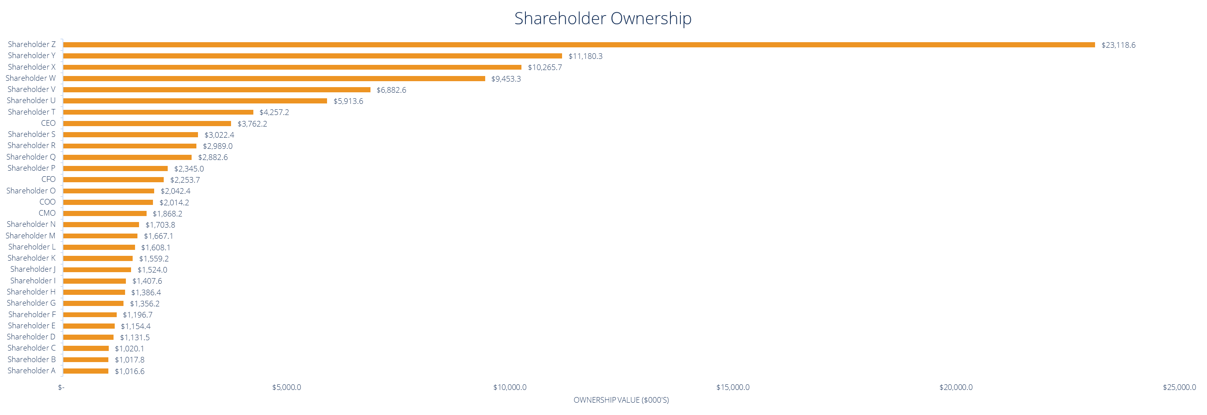
Shareholder Ownership
Ownership Analysis
(What is the breakdown between institutional/insider/retail ownership? What does this imply for float turnover? What is the float turnover?)
(Who are the top shareholders? How has this ownership dynamic changed over time? What are the key takeaways from this dynamic? What kinds of opportunities does this create? How has this activity impacted valuation?)
1
2
3
4
5
Company Overview
Industry Overview
Valuation
Transaction Opportunities
Team Overview
Notes:
\\TOCS2002\INVEST_DS\Multipub-creative\CREATIVE\Templates\Pitchbook Guidelines\TMT Templates - CIBC Excel.xls
Ownership Analysis (2)

Slide 9
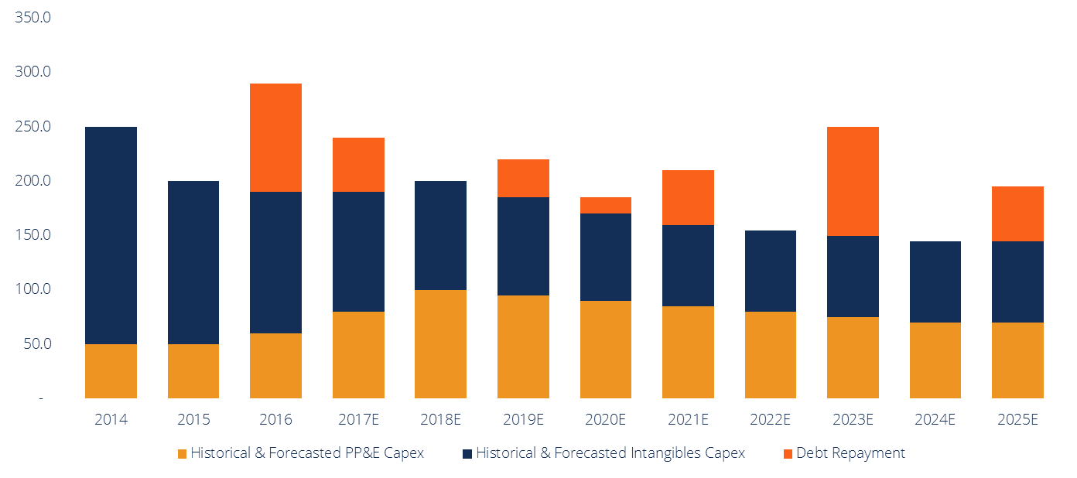
Liquidity Analysis
(What is the overarching theme? If your client takes away only one sentence from this slide, what should it be?)
Capital Adequacy
Capital intensity diminishes over time (Why is this happening? Is it signaling a strategic shift? What does this mean for liquidity? What is the split between growth and maintenance capex?)
Cash position improves over time (Why is this happening? How is this beneficial? What kinds of opportunities can Company A pursue with all this dry powder?)
(What are some potential pitfalls Company A might run into? How can these be avoided?)
(Where is capex expected to spike? Why? Are debt maturities evenly spaced out, or are they all within a short duration of each other? What does this mean?)
(in millions of U.S. dollars) | 2014 | 2015 | 2016 | 2017E | 2018E | 2019E | 2020E | 2021E | 2022E | 2023E | 2024E | 2025E
Historical & Forecasted PP&E Capex | 50.0 | 50.0 | 60.0 | 80.0 | 100.0 | 95.0 | 90.0 | 85.0 | 80.0 | 75.0 | 70.0 | 70.0
Historical & Forecasted Intangibles Capex | 200.0 | 150.0 | 130.0 | 110.0 | 100.0 | 90.0 | 80.0 | 75.0 | 75.0 | 75.0 | 75.0 | 75.0
Debt Repayment | - | - | 100.0 | 50.0 | - | 35.0 | 15.0 | 50.0 | - | 100.0 | - | 50.0
Debt Facility | Outs. ($mm) | Avail. ($mm) | Maturity | Interest rate | Notes
Convertible Senior Unsecured Notes
Revolving Credit Facility
1
2
3
4
5
Company Overview
Industry Overview
Valuation
Transaction Opportunities
Team Overview

Slide 10
Industry Overview

Slide 11

Competitive Environment
Company | EV/ LTM Sales | EV/ LTM EBITDA | Strategy | Structure
 | ** What are the relevant valuation metrics for comps? ** | (P/NAV? P/CF? EV/EBITDAR? etc.) | (Any recent developments? Analyst consensus / sentiment? Overarching themes? Stated growth strategies? Are they direct competitors?) | (What industry verticals do they operate in? What are their business segments? What’s the revenue split?)
(LOGO B) |  |  | (Any recent developments? Analyst consensus / sentiment? Overarching themes? Stated growth strategies? Are they direct competitors?) | (What industry verticals do they operate in? What are their business segments? What’s the revenue split?)
(LOGO C) |  |  | (Any recent developments? Analyst consensus / sentiment? Overarching themes? Stated growth strategies? Are they direct competitors?) | (What industry verticals do they operate in? What are their business segments? What’s the revenue split?)
(LOGO D) |  |  | (Any recent developments? Analyst consensus / sentiment? Overarching themes? Stated growth strategies? Are they direct competitors?) | (What industry verticals do they operate in? What are their business segments? What’s the revenue split?)
(LOGO E) |  |  | (Any recent developments? Analyst consensus / sentiment? Overarching themes? Stated growth strategies? Are they direct competitors?) | (What industry verticals do they operate in? What are their business segments? What’s the revenue split?)
(LOGO F) |  |  | (Any recent developments? Analyst consensus / sentiment? Overarching themes? Stated growth strategies? Are they direct competitors?) | (What industry verticals do they operate in? What are their business segments? What’s the revenue split?)
1
2
3
4
5
Company Overview
Industry Overview
Valuation
Transaction Opportunities
Team Overview

Slide 12
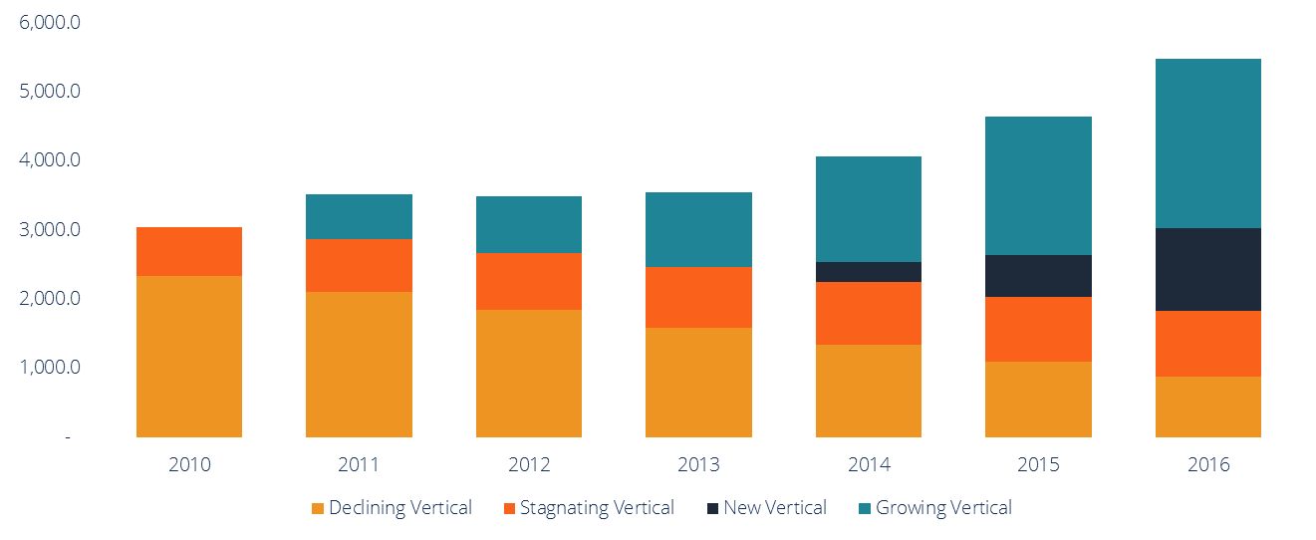
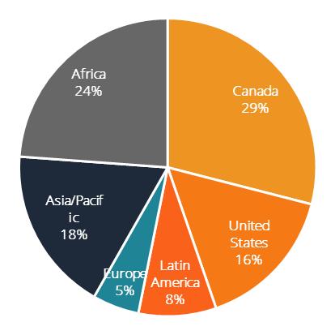
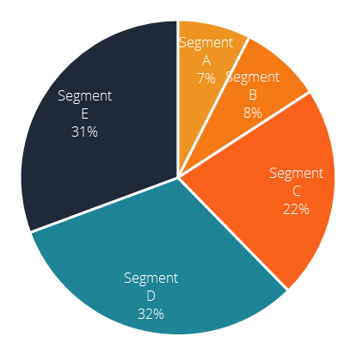
Key Industry Trends
Industry Review
Industry Spending
Industry Revenue Breakdown by Major Segment (2016)
Growing Vertical Revenue
New Vertical Revenue
Stagnating Vertical Revenue
Declining Vertical Revenue
Key Industry Averages
Total Debt/EBITDA
Total Debt/EV
EBITDA margin
EV/EBITDA
P/E Ratio
Market share of top 5 players
Global Industry
Total revenues
Forecasted 5-year revenue growth
Revenue Profile
(What are the secular trends in this industry? What is the industry outlook? What do the financial metrics imply?)
(What are the aggregate totals? Where have we witnessed deviant trends? Where have we witnessed convergent trends?)
31% CAGR
1
2
3
4
5
Company Overview
Industry Overview
Valuation
Transaction Opportunities
Team Overview

Slide 13
Corporate Finance Activity
Competitor A acquires X
Competitor A makes hostile bid for Company A
Competitor B divests X
Competitor C buys X
Competitor D IPO
Major product rollout by Company A
Competitor D completes follow-on offering
Competitor E acquires X
Competitor A acquires Competitor B
Competitor C files Chapter 11
2004 | 2005 | 2006 | 2007 | 2008 | 2009 | 2010
2011 | 2012 | 2013 | 2014 | 2015 | 2016 | 2017
Competitor G IPO
Competitor A acquires Competitor F
Competitor A divests X
Competitor G pulls IPO bid
Competitor D and Company A initiate joint venture
Competitor D 2:1 stock split
Company A initiates NCIB
Competitor C raises $1bn in Sr. Unsecured Notes
Competitor F IPO
Competitor C and Competitor D merge in a merger of equals
Company A acquires X
1
2
3
4
5
Company Overview
Industry Overview
Valuation
Transaction Opportunities
Team Overview

Slide 14
Valuation

Slide 15
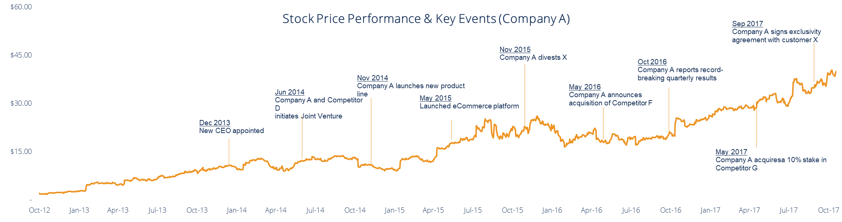
Historical Share Price Performance
Key Events & Share Price Drivers
Dec 2013 – Old CEO announces retirement; new CEO with 10 years’ industry experience appointed
Jun 2014 – Company A and Competitor D initiates joint venture, achieving economies of scales in their distribution channels
Nov 2014 – Company A rolls out Widget 2.0 product line available in store and online
May 2015 – Company A announces launch of new eCommerce platform; discontinues JV with Competitor D
Nov 2015 – Company A divests X; market reacts positively to low capital intensity moving forward
May 2016 – Company A announces acquisition of Competitor F pending antitrust regulatory approval
Oct 2016 – Company A reports record-breaking Q3 results, exceeding analyst consensus on both top line and EPS growth
May 2017 – Company A acquires 10% stake in Competitor G in opportunistic bid following poor post-IPO price performance from G
Sep 2017 – Company A signs 10-year exclusivity agreement with major online retailer, Customer X, to distribute Widget 2.0 on X’s platform
1
2
3
4
5
Company Overview
Industry Overview
Valuation
Transaction Opportunities
Team Overview

Slide 16
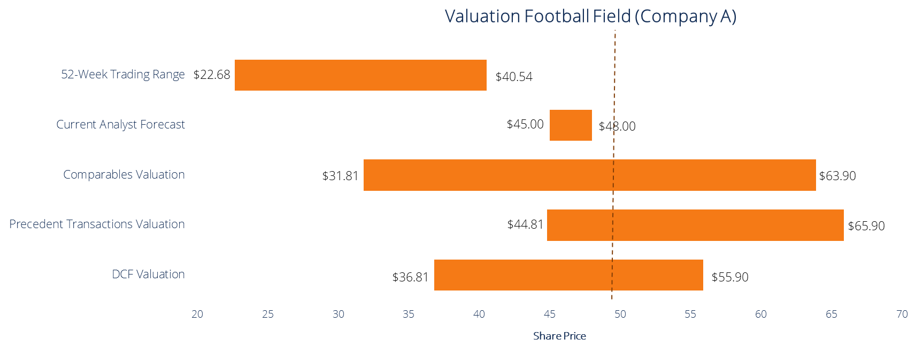
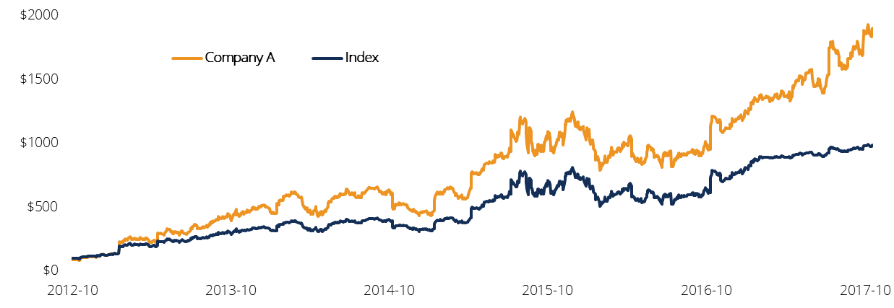
Valuation Summary
Stock Price Performance
Valuation Football Field
(How has Company A’s stock performed relative to the market index? By how much? Since when?)
(Are there any nuances regarding how the market is valuing Company A? What catalysts are priced in? What are not?)
(Is there a trend where the market rewards Company A for certain types of activity? Where is the stock trading at in terms of its 52-week range? Is there causality?)
(What’s the street consensus? What are common analyst themes? Do they think Company A is under/overvalued?)
Current: $40.00 | High: $50.15 | Low: $35.79
Broker Estimates | Target Prices ($) | ’18e Revenues ($mm) | ‘18e EBITDA ($mm) | ‘18e EBITDA Margin (%)
RBC (10/16/2017) | $46.00
J.P. Morgan (10/17/2017) | $45.00
BMO (10/20/2017) | $47.50
Morgan Stanley (10/21/2017) | $47.25
CIBC (10/27/2017) | $48.00
Valuation Metrics | Intrinsic | Trading | Precedents
EV/EBITDA
EV/Revenue
P/E
1
2
3
4
5
Company Overview
Industry Overview
Valuation
Transaction Opportunities
Team Overview

Slide 17
Valuation Analysis
Category | Assumptions |  | Comments
 | 2016A | 2017-2024E
EBITDA Margin |  |  | (What are your justifications as to why you chose these specific ranges of assumptions? Where do you see opportunity for growth/improvement? Do you believe the market is misunderstanding something? What do analysts think? Why do you deviate?)
Cost of Revenues
Marketing & Sales
Technology & Development
Operating Metric A
Operating Metric B
Purchases of PP&E
Purchases of Intangibles
1
2
3
4
5
Company Overview
Industry Overview
Valuation
Transaction Opportunities
Team Overview

Slide 18
Comparables Analysis
Comparable Company Rationale
(What is the reasoning behind choosing this particular peer set? Do they have similar business models? Are they direct competitors?)
(What are the key similarities that you’ve identified in this peer set in terms of operations? Strategy? What are the differences?)
(Which company is the closest proxy for Company A? Why? Which company is outperforming Company A? How can Company A be better than this outperformer?)
(in millions of U.S. dollars) |  | Stock | Equity | Firm | EV / Revenue |  |  |  | EV / EBITDA |  |  |  | Price / Earnings
Company | Symbol | Price | Value | Value | 2016A | LTM | NTM | 2018E | 2016A | LTM | NTM | 2018E | 2016A | LTM | NTM | 2018E
Competitor A | A.TO | $41.00 | $8,015 | $7,573 | 2.0x | 5.0x | 3.6x | 2.3x | 10.7x | 9.3x | 10.4x | 7.6x | 100.7x | 54.8x | 51.6x | 40.6x
Competitor B | B.TO | $3.59 | $2,494 | $3,104 | 3.1x | 6.6x | 5.7x | 4.9x | 7.5x | 15.2x | 13.9x | 5.5x | 109.3x | 53.8x | 64.7x | 48.6x
Competitor C | C.TO | $27.22 | $6,116 | $6,722 | 3.9x | 2.0x | 6.4x | 5.5x | 11.9x | 11.2x | 10.8x | 11.9x | 94.7x | 62.2x | 43.3x | 43.5x
Competitor D | D.TO | $16.78 | $4,278 | $4,606 | 5.8x | 5.9x | 5.9x | 1.2x | 7.7x | 6.1x | 5.0x | 14.0x | 89.8x | 64.2x | 65.4x | 52.5x
Competitor E | E.TO | $13.99 | $2,533 | $2,952 | 4.5x | 3.9x | 1.8x | 2.6x | 6.8x | 5.8x | 13.2x | 6.8x | 105.1x | 67.8x | 61.3x | 56.0x
Competitor F | F.TO | $26.37 | $10,190 | $11,025 | 7.0x | 7.2x | 5.1x | 6.1x | 9.1x | 15.2x | 7.3x | 10.9x | 93.7x | 70.6x | 41.7x | 55.0x
Competitor G | G.TO | $22.48 | $2,559 | $2,349 | 3.5x | 6.7x | 2.3x | 2.6x | 7.9x | 13.0x | 7.2x | 7.4x | 113.5x | 64.7x | 62.1x | 55.9x
Competitor H | H.TO | $17.68 | $7,358 | $7,215 | 5.5x | 5.2x | 2.4x | 0.8x | 7.2x | 9.6x | 7.9x | 6.4x | 90.6x | 47.4x | 51.7x | 57.7x
Competitor I | I.TO | $13.80 | $7,744 | $7,376 | 3.9x | 3.5x | 2.9x | 2.7x | 10.5x | 9.5x | 9.0x | 8.5x | 99.5x | 51.8x | 49.7x | 39.6x
Company A | A | $40.00 | $2,228 | $2,627 | 3.9x | 3.5x | 2.9x | 2.7x | 10.5x | 9.5x | 9.0x | 8.5x | 99.5x | 51.8x | 49.7x | 39.6x
High |  |  | $10,190 | $11,025 | 7.0x | 7.2x | 6.4x | 6.1x | 11.9x | 15.2x | 13.9x | 14.0x | 113.5x | 70.6x | 65.4x | 57.7x
Median |  |  | $5,197 | $5,664 | 3.9x | 5.1x | 3.2x | 2.7x | 8.5x | 9.5x | 9.0x | 8.1x | 99.5x | 58.5x | 51.7x | 50.5x
Mean |  |  | $5,352 | $5,555 | 4.3x | 5.0x | 3.9x | 3.1x | 9.0x | 10.4x | 9.4x | 8.7x | 99.6x | 58.9x | 54.1x | 48.9x
Low |  |  | $2,228 | $2,349 | 2.0x | 2.0x | 1.8x | 0.8x | 6.8x | 5.8x | 5.0x | 5.5x | 89.8x | 47.4x | 41.7x | 39.6x
1
2
3
4
5
Company Overview
Industry Overview
Valuation
Transaction Opportunities
Team Overview

Slide 19
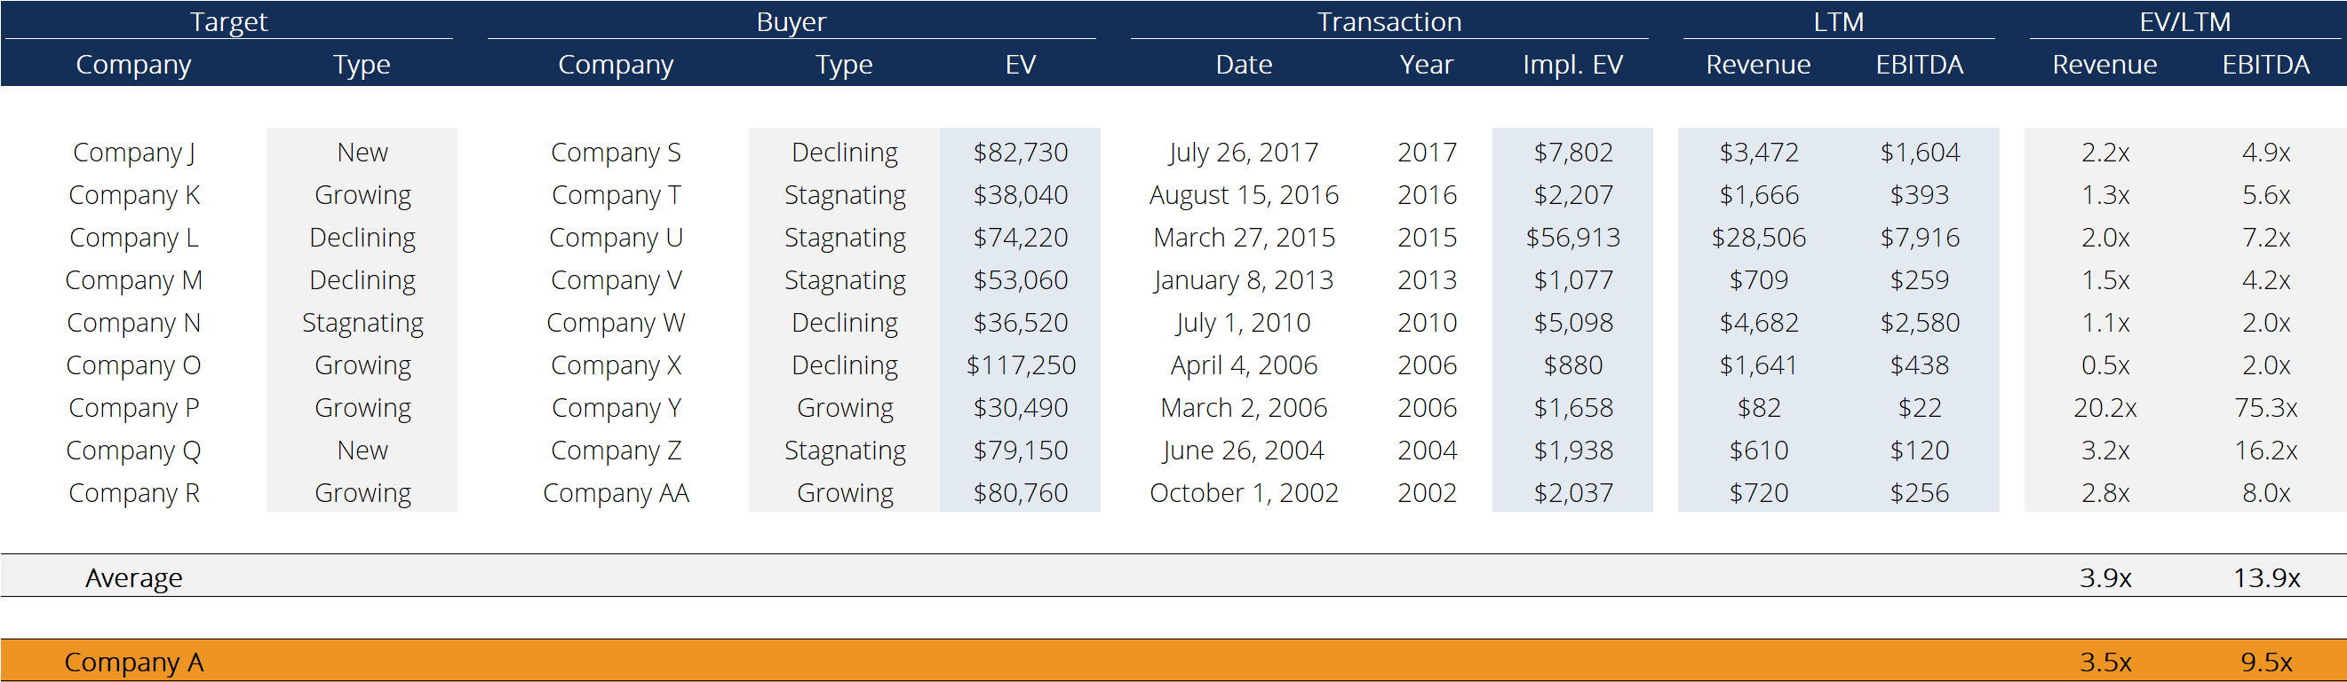
Precedents Analysis
Precedent Transaction Rationale
(Which transactions did you select to value Company A? Why? What similarities exist between the target and Company A?)
(In what ways would Company A command a higher TV if they were put in the position of a target? What competitive advantages does Company A have over past transaction targets?)
(How are the industry verticals classified relative to Company A and its strategy? Is there an identifiable trend over time regarding industry multiples? Are they contracting or expanding? Why? What’s the secular driver within the industry?)
1
2
3
4
5
Company Overview
Industry Overview
Valuation
Transaction Opportunities
Team Overview

Slide 20
Transaction Opportunities

Slide 21
Strategic Review and Opportunities
M&A Opportunities
Reco 1:
Key Transaction Theme 1: (In short, why should this theme be the focal point for Company A’s management team?)
(Why will this be the game-changing opportunity for Company A? Why is the timing ideal right now?)
Key Transaction Theme 2:
VALUATION OVERVIEW
Industry Vertical A:
EV/EBITDA: 0.0x – 0.0x
EV/Revenue: 0.0x – 0.0x
P/E: 0.0x – 0.0x
Industry Vertical B:
EV/EBITDA: 0.0x – 0.0x
EV/Revenue: 0.0x – 0.0x
P/E: 0.0x – 0.0x
(What observations can you make about the range of multiples? What insights can be gained from the differences? What is the industry trending towards?)
Company A:
EV/EBITDA: 2.9x
EV/Revenue: 3.5x
P/E: 51.8x
(Where does Company A stand in terms of relative industry valuation? Why is it currently trading at a premium/discount?)
All multiples are NTM
Reco 2:
Key Transaction Theme 1:
Key Transaction Theme 2:
Key Transaction Theme:
Reco 3:
1
2
3
4
5
Company Overview
Industry Overview
Valuation
Transaction Opportunities
Team Overview

Slide 22
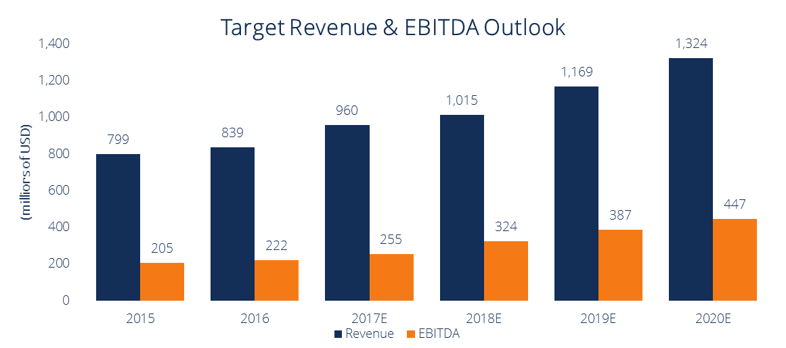
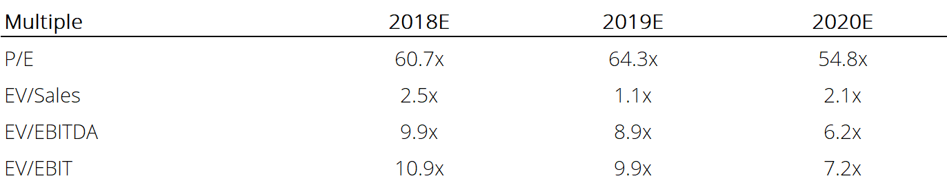
Recommendation 1
Strategic Rationale
Target Revenue & EBITDA Forecast
(Ideally, you will want to show the accretion/dilution at different control premiums, showcase potential synergies, and demonstrate a multiple re-rating in the market following the acquisition)
(How does this target company fit in with Company A’s strategy? What are some of the intangible elements like customer relationships or human capital talent that Company A will receive in the acquisition?)
(Why now? Timing considerations?)
Prime Target Company Overview
Valuation Multiples
Prime Target
1
2
3
4
5
Company Overview
Industry Overview
Valuation
Transaction Opportunities
Team Overview

Slide 23

Recommendation: Content/Production Focus
Strategic Rationale
Target A Revenue & EBITDA
(When pitching a transaction opportunity to company management, it is best to give your top recommendation first as their time is valuable. If they are not interested in the first transaction, the next two recommendations are there to serve as a backup.)
(There should still be strong strategic rationale to pursue these transactions, what are they? Are there diversification opportunities available? Scaling opportunities? Etc.)
Acquisition Opportunities
Target A Revenue & EBITDA Forecast
Target A
Target B
1
2
3
4
5
Company Overview
Industry Overview
Valuation
Transaction Opportunities
Team Overview
Notes:
“ 1,000 key Grand Hyatt-managed hotel, 2,000 condominium hotel units totaling approximately 2,232,000 square feet, a 75,000 square foot casino, 275,000 square feet of retail and restaurant space, 150,000 square feet of meeting and ballroom space” - http://greatlasvegascondos.com/cosmopolitan_construction_financing.htm
2,200 condo-hotel units or 2,000 units?
“Approximately 2,700 keys comprised of luxury condo-hotel units and hotel rooms with over 1,700 condo-hotel units offered for sale” - http://www.hotel-online.com/News/PR2005_2nd/Apr05_HyattCosmopolitan.html
“- Initial developer Ian Eichner exhausts project funding / defaults on construction loans of $760 million and enters foreclosure” - http://www.examiner.com/article/cosmopolitan-the-rocky-past-and-uncertain-future-of-the-newest-vegas-resort
- Confirmed at 760 with Bloomberg article
€500m write-off in 2009 (annual report 2010) ~ $750m

Slide 24
Recommendation: Content/Production Focus
Strategic Rationale
Target C Revenue & EBITDA
(When pitching a transaction opportunity to company management, it is best to give your top recommendation first as their time is valuable. If they are not interested in the first transaction, the next two recommendations are there to serve as a backup.)
(There should still be strong strategic rationale to pursue these transactions, what are they? Are there diversification opportunities available? Scaling opportunities? Etc.)
Acquisition Opportunities
Target C Revenue & EBITDA Forecast
Target C
Target D
1
2
3
4
5
Company Overview
Industry Overview
Valuation
Transaction Opportunities
Team Overview
Notes:
“ 1,000 key Grand Hyatt-managed hotel, 2,000 condominium hotel units totaling approximately 2,232,000 square feet, a 75,000 square foot casino, 275,000 square feet of retail and restaurant space, 150,000 square feet of meeting and ballroom space” - http://greatlasvegascondos.com/cosmopolitan_construction_financing.htm
2,200 condo-hotel units or 2,000 units?
“Approximately 2,700 keys comprised of luxury condo-hotel units and hotel rooms with over 1,700 condo-hotel units offered for sale” - http://www.hotel-online.com/News/PR2005_2nd/Apr05_HyattCosmopolitan.html
“- Initial developer Ian Eichner exhausts project funding / defaults on construction loans of $760 million and enters foreclosure” - http://www.examiner.com/article/cosmopolitan-the-rocky-past-and-uncertain-future-of-the-newest-vegas-resort
- Confirmed at 760 with Bloomberg article
€500m write-off in 2009 (annual report 2010) ~ $750m

Slide 25
Team Overview

Slide 26
Investment Banking Team
Precedent Transaction Rationale
“Our team is composed of a comprehensive roster of experienced and knowledgeable seniors and juniors to execute this transaction”
(For sell-side pitchbooks: What previous transaction experience does the team have? What is their background and education? How many years experience in the industry? What previous relevant positions have the directors held?)
(For buy-side pitchbooks: How extensive are the personnel resources of the bank? What divisions of the bank can contribute to what element of the transaction? How can I contact the different individuals listed?)
M&A Group
First Last Name – Position, Head of, Group Phone Number Email Address
Equity Capital Markets
First Last Name – Position, Head of, Group Phone Number Email Address
Debt Capital Markets
First Last Name – Position, Head of, Group Phone Number Email Address
Industry Group
First Last Name – Position, Head of, Group Phone Number Email Address
Team Leaders
First Last Name – Position, Head of, Group Phone Number Email Address
Leveraged Finance
First Last Name – Position, Head of, Group Phone Number Email Address
Industry Group
First Last Name – Position, Head of, Group Phone Number Email Address
Satellite Office
First Last Name – Position, Head of, Group Phone Number Email Address
Private Equity
First Last Name – Position, Head of, Group Phone Number Email Address
1
2
3
4
5
Company Overview
Industry Overview
Valuation
Transaction Opportunities
Team Overview

Slide 27
Deal Tombstones
Notable Past Transactions
Company Name
$ Deal Amount
Deal Unit Size Deal Type
Deal Position
DATE
Company Name
$ Deal Amount
Deal Unit Size Deal Type
Deal Position
DATE
Company Name
$ Deal Amount
Deal Unit Size Deal Type
Deal Position
DATE
Company Name
$ Deal Amount
Deal Unit Size Deal Type
Deal Position
DATE
Logo:
.PNG format
Logo:
.PNG format
Logo:
.PNG format
Company Name
$ Deal Amount
Deal Unit Size Deal Type
Deal Position
DATE
Company Name
$ Deal Amount
Deal Unit Size Deal Type
Deal Position
DATE
Company Name
$ Deal Amount
Deal Unit Size Deal Type
Deal Position
DATE
Company Name
$ Deal Amount
Deal Unit Size Deal Type
Deal Position
DATE
Logo:
.PNG format
Logo:
.PNG format
Logo:
.PNG format
Logo:
.PNG format
1
2
3
4
5
Company Overview
Industry Overview
Valuation
Transaction Opportunities
Team Overview
Notes:
Tombstone guidelines can be found at - \\TOCS2002\INVEST_DS\multipub\CREDENTIALS\Tombstones\Tombstone Guidelines 2003.ppt

Slide 28
Appendices

